Slide 1
eBay Used Cars Database
Group 1
Artificial Intelligence involving Exploratory Data Analysis
Jamal Lartey
Daniel Amissah
Malik Abdul
Jason Garshong

Slide 2
Hypothesis
Using the independent variables available in the eBay Used Car repository data, the price of a car could be predicted.
https://www.kaggle.com/orgesleka/used-cars-database

Slide 3
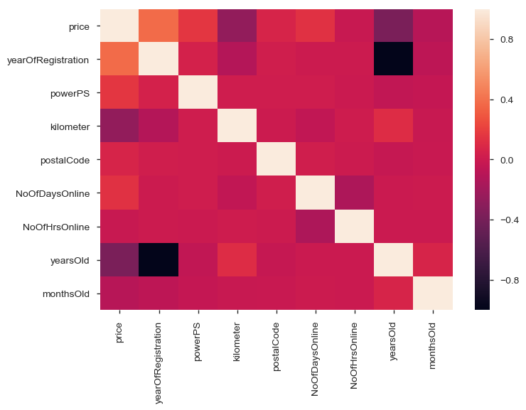
Pearson Correlation

Slide 4
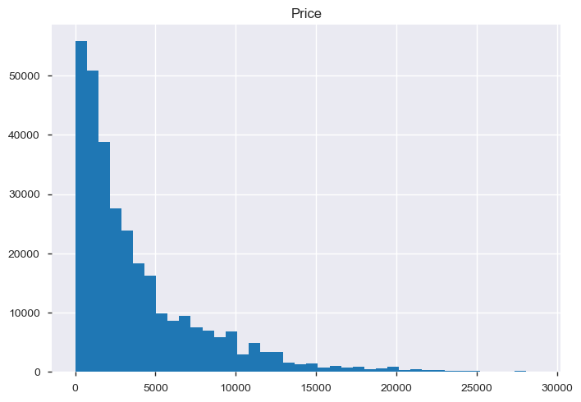
Variables: Price
The price on the ad to sell the car.
A lot of records has price as zero and very few has price greater than 20,000, with 28,800 being the most

Slide 5
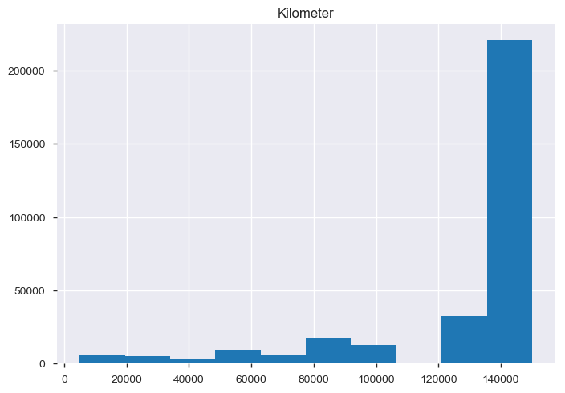
Variables: Kilometer
How many kilometers the car has been driven.
Since the data is of used cars, most of the cars have mileage acquired, but most of the cars have between 12,000 to 15,000 kilometer under the belt.

Slide 6
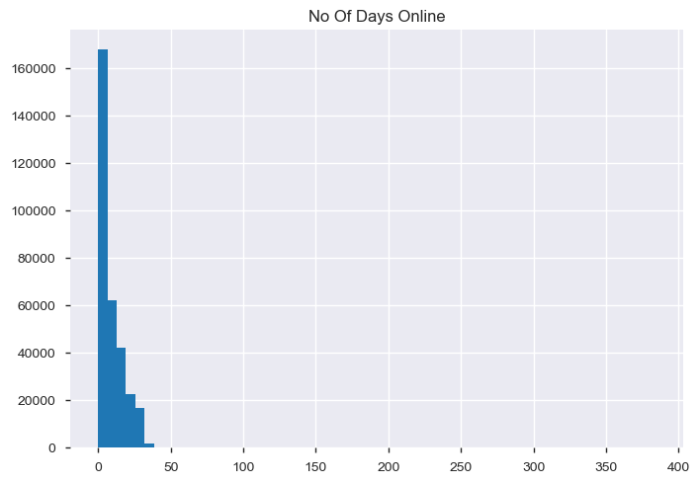
Variables: Days Online
Number of days the car has been listed online.
Majority of the cars came online very recently, under 10 days. But there is an outlier that has been online for 384 days.

Slide 7
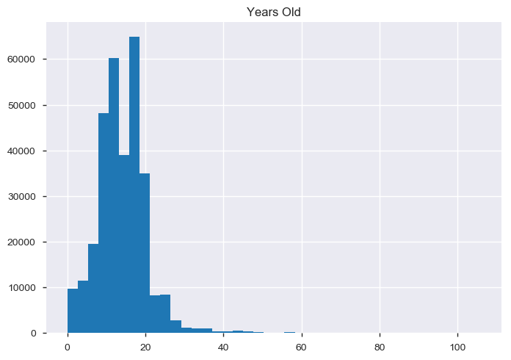
Variables: Years Old
Age of the car in years.
Most of the cars are between 10 to 20 years old, with an outlier of 106 years old car.

Slide 8
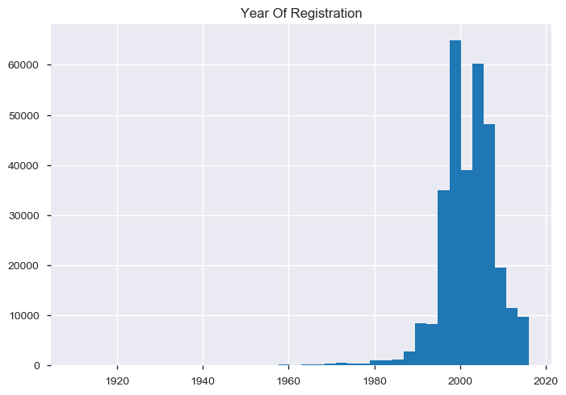
Variables: Year of Registration
At which year the car was first registered.
We can see that even after filtering the dataset between 1890 and 2016, we have an outlier at 1910. Most of the listed cars are registered between 1990 and 2015.

Slide 9
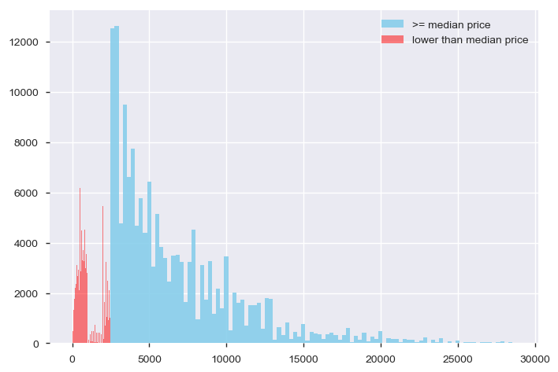
Probability Mass Function

Slide 10
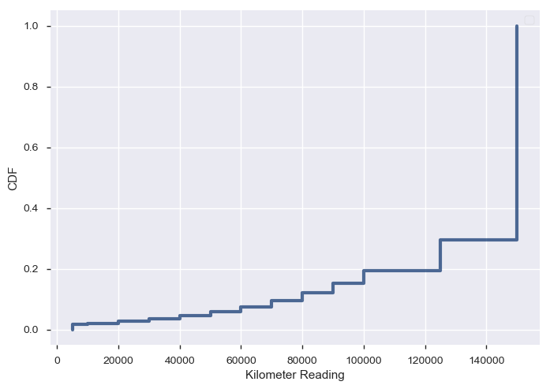
Cumulative Distribution Function

Slide 11
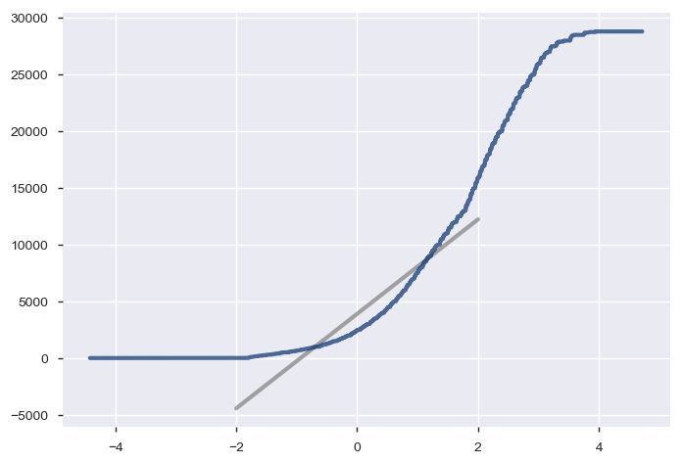
Analytical Distribution

Slide 12
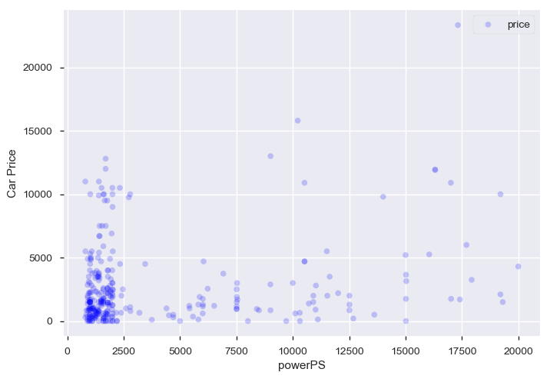
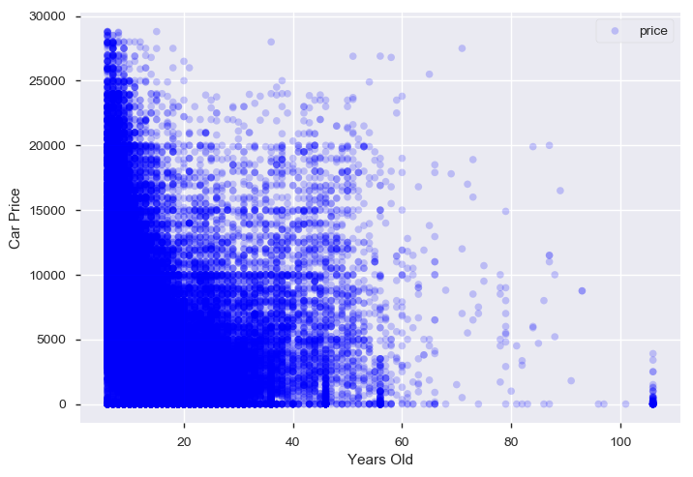
Scatter Plots

Slide 13
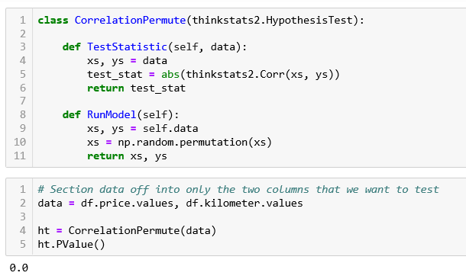
Hypothesis Testing

Slide 14
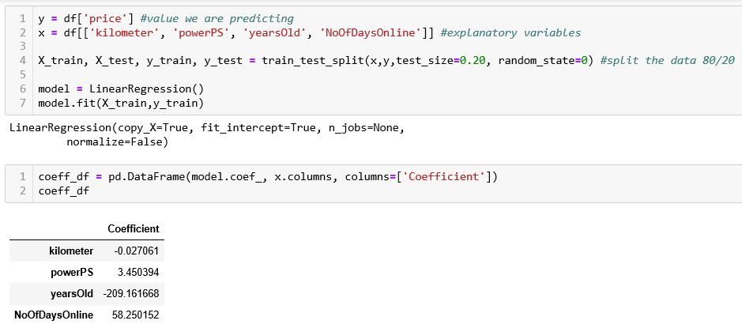
Regression Analysis

Slide 15
End of Presentation
Thanks for your audience

